Slide 1

Vishwakarma Institute of Technology
Topic – Face Recognition Based Student Attendance System
Division - SY-IT-A
Group no. 4
Guide - Prof. Deepali Joshi
Members:
1.Shinde Tejas-61
2.Vanjari Atharv-63
3.Vishal Singh-65
4.Harshada Giri-75
5.Priti Patil-82

Slide 2
OUTLINE
Introduction
Objectives
Literature review
Tools used
Methodology
Algorithm
Result
Merits And Demerits
Conclusion
Future Scope
References

Slide 3
INTRODUCTION
A facial recognition system is a technology capable of matching a human face from a digital image or a video frame against a database of faces, typically employed to authenticate users through ID verification services, works by pinpointing and measuring facial features from a given image.
Computerised facial recognition involves the measurement of a human's physiological characteristics.
Facial recognition systems are categorized as biometrics.

Slide 4
OBJECTIVES
Our primary goal is to improve and organise the process of tracking and managing the student attendance. We seek to :
Provide a valuable attendance service for teachers.
Reduce manual process errors by providing an automated and a reliable attendance system using face recognition technology.
Able to recognise the face of an individual accurately based on the face database.

Slide 5
LITERATURE REVIEW
Sr No. | Paper Name | Publication Year | Method used | Algorithm
1 | Face recognition based smart attendance system | 2020 | The Local Binary Pattern Histogram (LBPH) algorithm is used | Database can be created by taking images from the camera. Then converting the images into grayscale images and generate histogram and use LBPH algorithm to match the cropped face with the face database images
2 | Face recognition Based Attendance System Using Machine Learning Algorithms | 2018 | CA and LDA method for face recognition | The pre-trained module is trained with number of images. SVM, MLP and CNN are used as a classifier to evaluate the face recognition. The SVM, MLP and CNN achieves the testing accuracy of 87%, 86.5% and 98% respectively
3 | Student Attendance System Using Face Recognition | 2020 | Haar cascade for face detection and KNN, CNN and SVM are used for face recognition. | For face recognition, three algorithms i.e KNN, CNN and support vector machines are used. KNN algorithm has proved to have the highest accuracy of 99.27%, CNN has low computational complexity and SVM algorithm proved to be less efficient.

Slide 6
LITERATURE REVIEW
Sr No. | Paper Name | Publication Year | Method used | Algorithm
4 | Face Recognition based Class Management and Attendance System | 2020 | System is developed using Python, GUI, sqlite3 and OpenCV. Haar cascade is used for face detection and LBPH algorithm is used for face recognition. | Haar Cascade provides a high accuracy level irrespective of the illumination. The system can give an accuracy of about 96.88%. The faculty can also manage the class data along with the record of the attendance through this system
5 | Face Recognition for Attendance System Detection | 2018 | Face detection was done using Haar Cascade algorithm. The face extraction was performed using LBPH algorithm | The face detection process was performed using Haar Cascade algorithm. If the face is detected, it would draw a box that covers the face as an ROI. The feature extraction was performed using LBPH algorithm.
6 | PCA based Facial Recognition for attendance system | 2020 | The face detection was done using Haar Cascade algorithm. The face recognition method was performed using PCA algorithm | The image will be converted into gray scale and stored in the database. The face recognition is done by comparing the values obtained to the values stored in the database. If the values match, the name related with that face is shown.

Slide 7
LITERATURE REVIEW
Sr No. | Paper Name | Publication Year | Method used | Algorithm
7 | Class Attendance Management System Using Face Recognition | 2018 | The facial recognition is done by implementing Local Binary Pattern Histogram (LBPH). | The first processing step is to detect and crop the ROI which is the human face. It can be done by applying the Haar Feature-based Cascade algorithm. After that, the image features are extracted using LBP, then LBP algorithm compares the extracted features with the trained dataset
8 | Real-Time Image Processing: Face Recognition based Automated Attendance System in-built with “Two-Tier Authentication” Method | 2020 | Faster R-CNN is used for face detection | The system is designed to operate in a classroom that has two cameras on opposite ends so that every student is captured by at least one of the cameras. Each student has a unique ID through which the student is mapped into the database

Slide 8
REQUIRED TOOLS
VS Code - Visual Studio Code is a code editor with support for development operations like debugging, task running, and version control.
Libraries :
OpenCV - OpenCV is a library of programming functions mainly aimed at real-time computer vision.
NumPy - NumPy is a library for the Python programming language, adding support for large, multi-dimensional arrays and matrices.
Tkinter - Tkinter is the standard GUI library for Python. Python when combined with Tkinter provides a fast and easy way to create GUI applications.

Slide 9
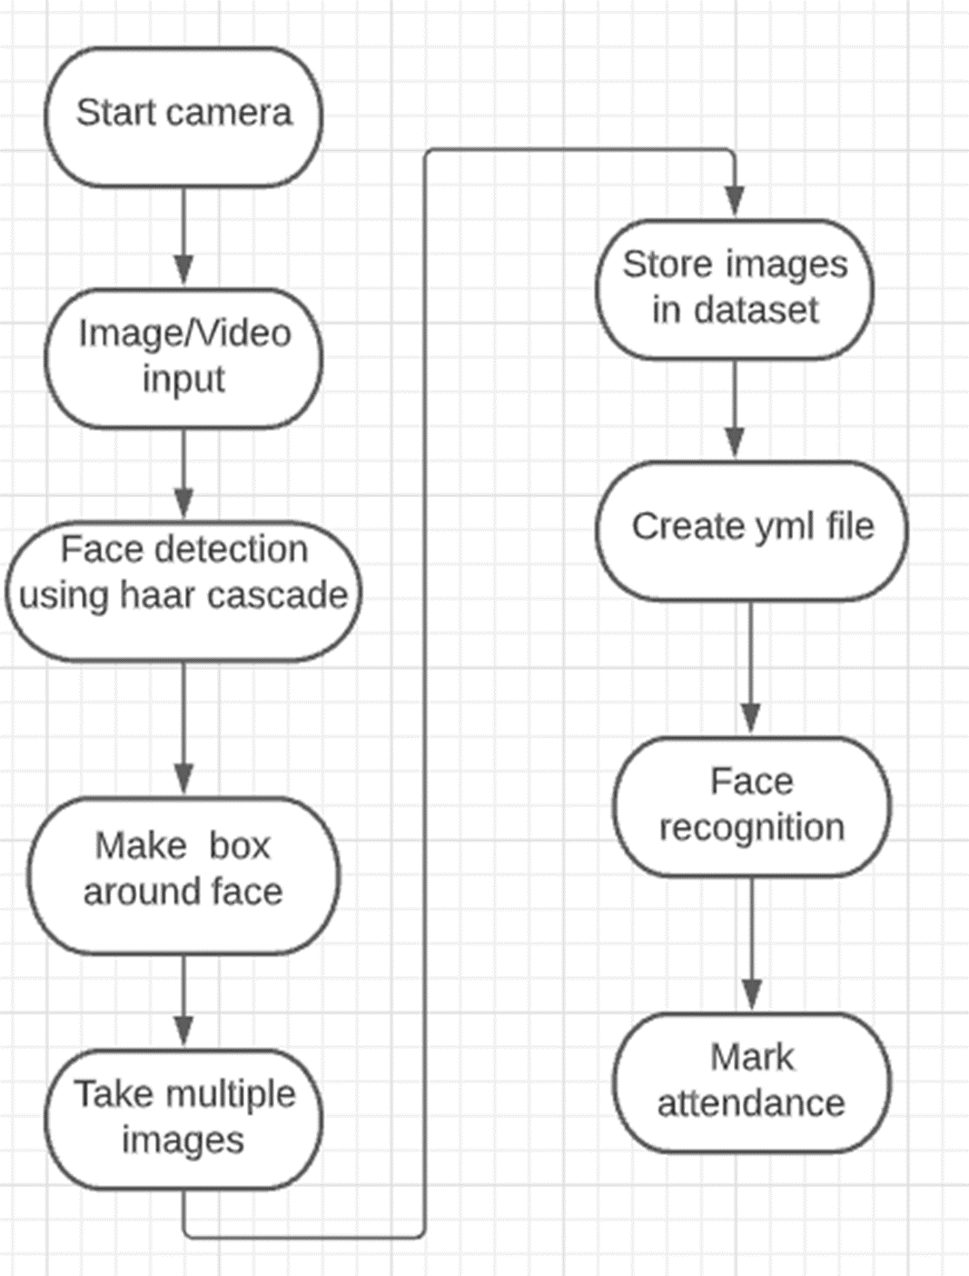
METHODOLOGY
•Block Diagram:
The Whole process basically starts by capturing the images from the input video stream.
The Haar Cascade algorithm makes a box around the face of the student and starts capturing the multiple images of the student.
The images are then converted to grayscale and stored in the dataset.
Then, the model is trained with the help of those images using LPBH algorithm and yml file is generated.
Then, we start the tracking process and for face recognition we use the LBPH algorithm

Slide 10
METHODOLOGY
Algorithm steps involved are:
1.Face Detection
2.Training file
3.Face Recognition
4.Mark Attendance

Slide 11
METHODOLOGY
The LPBH algorithm is a part of OpenCV.
1.Start Camera
The first step is to start the webcam and get the video stream as the input for the system. After starting the video, the main task is to detect the human face in it so that the image of the face can be taken, stored, and then used for face recognition task.
2.Face Detection
The face detection is performed using Haar Cascade algorithm.
This algorithm for object detection is capable of running in the real-time.
3.Training the File
The next step performed by the system is to store the images into the dataset folder
Now the system needs to generate a histogram out of those images which are taken.
System also needs to train the model by using those images. The model will be trained using LBPH algorithm.

Slide 12
METHODOLOGY
4.Face Recognition
Along with the face detection, Face recognition is very necessary. Face recognition in this system is performed using the LBPH algorithm.
Local Binary Pattern (LBP) is a basic yet effective texture operator that labels pixels in an image by thresholding each pixel's neighbourhood and treating the result as a binary number.
Steps:
Suppose we have an image having dimensions M x M.
We can get part of this image as a window of 3x3 pixels.
oIt can also be represented as a 3x3 matrix containing the intensity of each pixel (0~255).

Slide 13
METHODOLOGY
4.Face Recognition
Along with the face detection, Face recognition is very necessary. Face recognition in this system is performed using the LBPH algorithm.
Local Binary Pattern (LBP) is a basic yet effective texture operator that labels pixels in an image by thresholding each pixel's neighbourhood and treating the result as a binary number.
Steps:
Suppose we have an image having dimensions M x M.
We can get part of this image as a window of 3x3 pixels.
oIt can also be represented as a 3x3 matrix containing the intensity of each pixel (0~255).

Slide 14
ALGORITHM
Haar Cascade -
It is an Object Detection Algorithm used to identify faces in an image or a real time video. The algorithm uses edge or line detection features proposed by Viola and Jones in their research paper “Rapid Object Detection using a Boosted Cascade of Simple Features” published in 2001. The algorithm is given a lot of positive images consisting of faces, and a lot of negative images not consisting of any face to train on them.

Slide 15
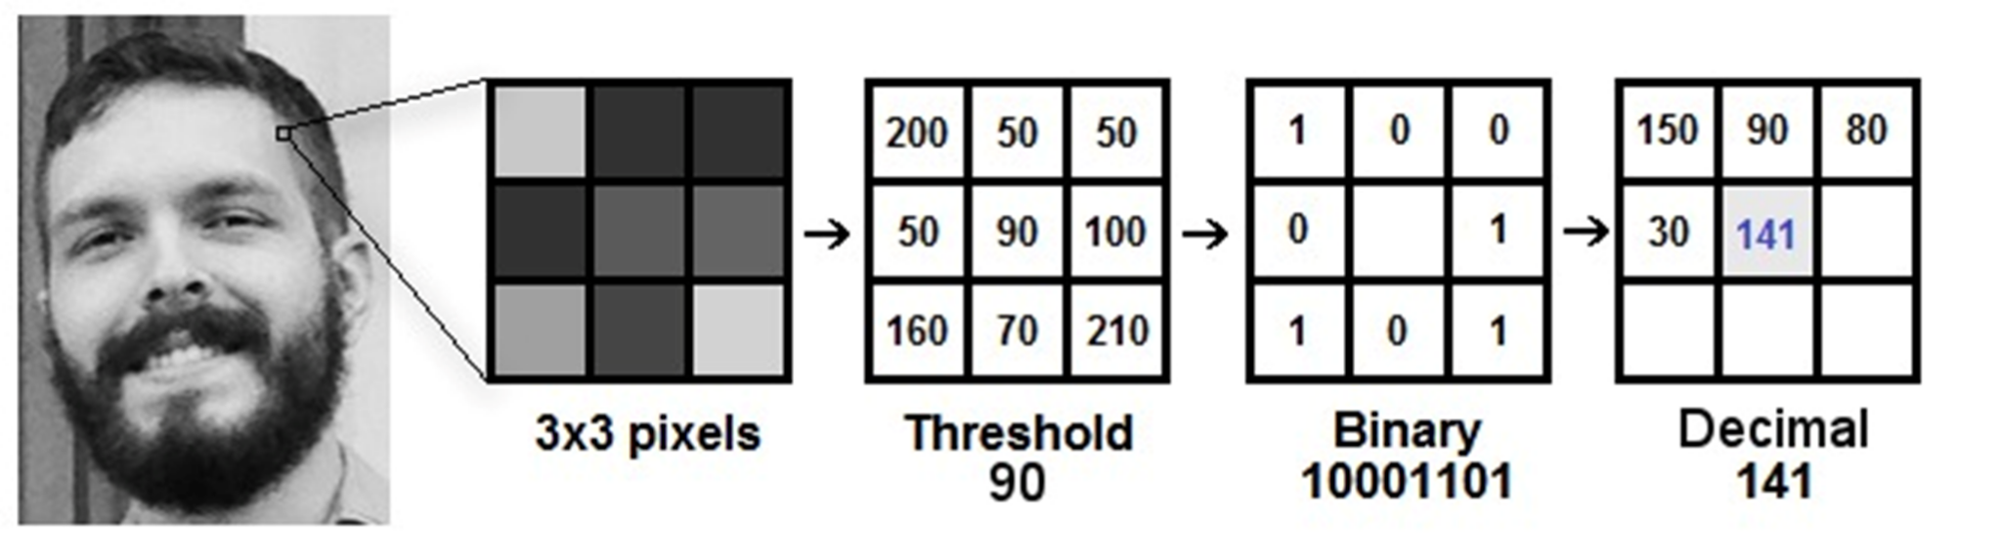
ALGORITHM
Local Binary Pattern (LBP) -
It is a simple yet very efficient texture operator which labels the pixels of an image by thresholding the neighbourhood of each pixel and considers the result as a binary number. Using the LBP combined with histograms we can represent the face images with a simple data vector. As LBP is a visual descriptor it can also be used for face recognition tasks, as can be seen in the following step-by-step explanation.

Slide 16
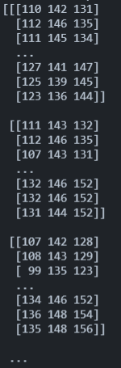
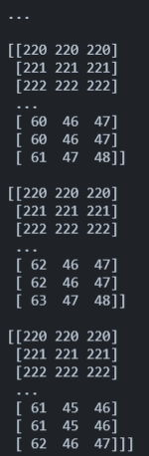

Example:
INPUT: OUTPUT:
ALGORITHM
The system will extract the pixel values in the form of matrix from the input image.

Slide 17
ALGORITHM
The rule for finding LBP of an image is as follows:
Set a pixel value as center pixel.
Collect its neighborhood pixels (total number of neighborhood pixel is 8)
Threshold it’s neighborhood pixel value to 1 if its value is greater than or equal to center pixel value otherwise threshold it to 0.
After thresholding, collect all threshold values from neighborhood clockwise.The collection will give you an 8-digit binary code. Convert the binary code into decimal.
Replace the center pixel value with resulted decimal and do the same process for all pixel values present in image.
At the end of this procedure (LBP procedure), we have a new image which represents better characteristics of the original image.
127 | 141 | 147
125 | 139 | 145
123 | 136 | 144
0 | 1 | 1
0 | 139 | 1
0 | 0 | 1
AFTER THRESHOLDING

Slide 18
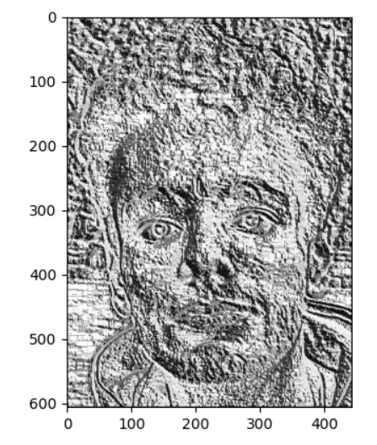
ALGORITHM
The binary value we got is:
Converting the binary value into decimal value:
0 × 2⁷ + 1 × 2⁶ + 1 × 2⁵ + 1 × 2⁴ + 0 × 2³ + 0 × 2² + 0 × 2¹ + 0 × 2⁰ = 112
Replacing the centre pixel value with the decimal value i.e., 112:
Now, System will do this same process for all the pixel values present
in the image.
0 | 1 | 1 | 1 | 0 | 0 | 0 | 0
Input (Original Image)
127 | 141 | 147
125 | 112 | 145
123 | 136 | 144
Output (LBP image)

Slide 19
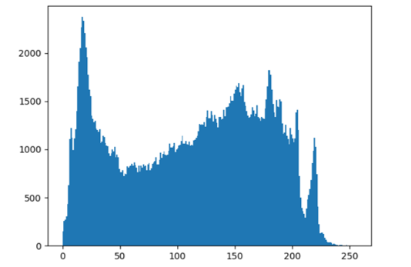
ALGORITHM
The System uses two parameters which are Grid X and Grid Y, to divide the image into large number of grids , So that it can extract the histogram.
Each histogram which is created, will be used to represent image from the training dataset.
So, given an input image, The system will perform the steps again for this latest image and create a histogram which represents the image
So, to find the image that perfectly matches the input image, System will only need to compare both the histograms and return the image with most matching histogram.

Slide 20
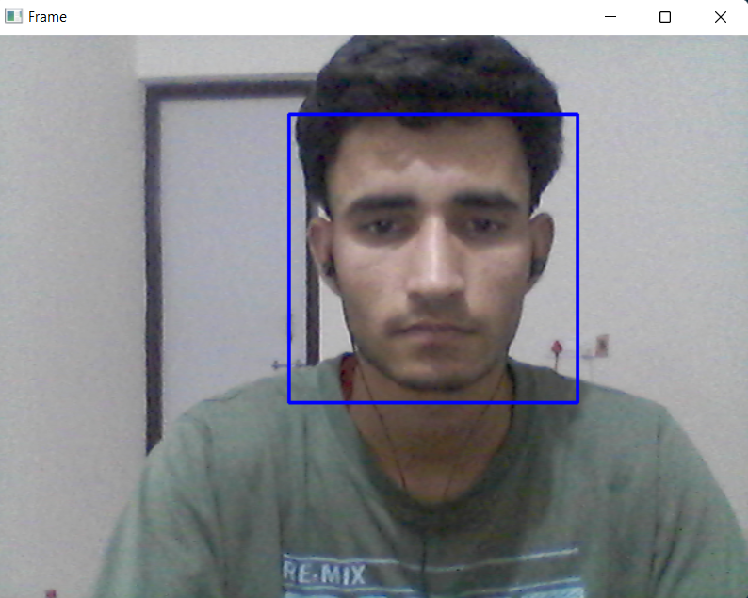
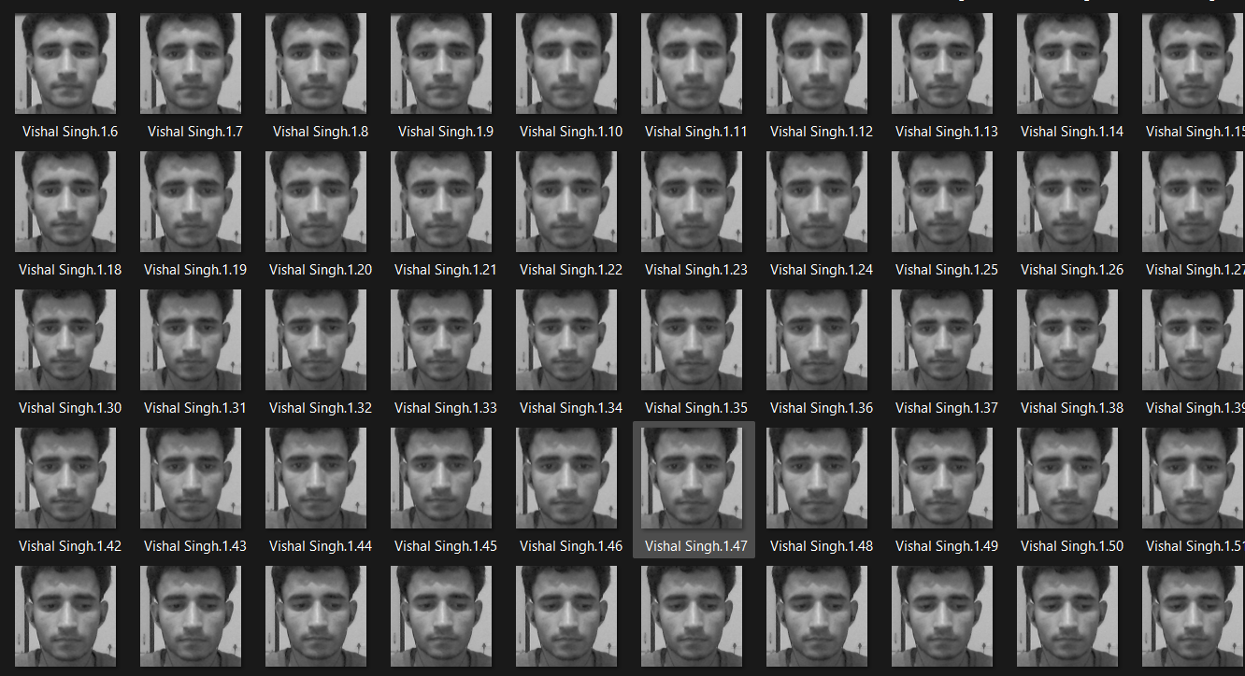
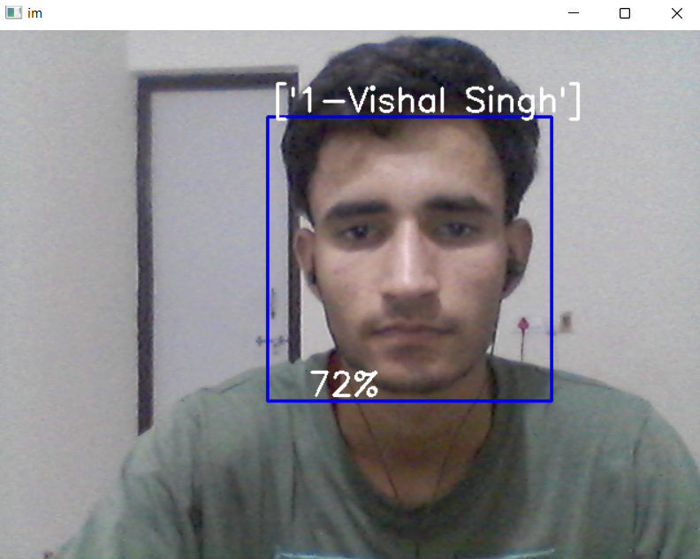
SCREENSHOTS
Fig:- Face Detection
Fig:- Dataset created
Fig:- Face Recognised

Slide 21
MERITS AND DEMERITS
MERITS
The system stores the faces that are detected and automatically marks attendance.
Provide authorized access.
Ease of use.
Multiple face detection.
DEMERITS
The accuracy of the system is not 100%.
Face detection and loading training data process is a little bit slow.
Will not recognizes person in mask/veil.

Slide 22
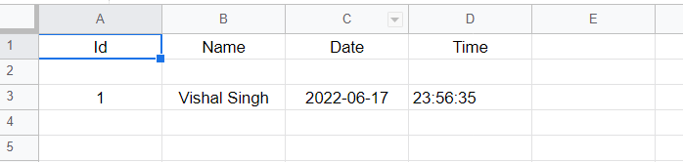
Result
Teachers will not need to worry about the attendance anymore as the system will automatically take the attendance of the students present in the classroom and store it in an excel sheet.
The teacher can see the attendance in the csv file at any time.

Slide 23
CONCLUSION
This system introduces the efficient method of attendance management system in the classroom environment that can replace the old manual methods.
This method is secure enough, reliable, accurate and efficient. There is no need for specialized hardware for installing the system in the classroom.
It can be constructed using a camera and computer. There is a need to use some algorithms that can recognize the faces in veil to improve the system performance.
The system will save time, reduce the amount of work the administration had to do and will replace the stationery material with electronic apparatus and reduces the amount of human resource required for the purpose.

Slide 24
FUTURE SCOPE
Almost all academic institutions require attendance record of students and maintaining attendance manually can be hectic as well as time consuming task. Hence maintaining attendance automatically with the help of face recognition will be very helpful and less prone to errors as compared to manual process.
This will also reduce manipulation of attendance record done by students and it will save time as well.
The future scope of the proposed work can be, capturing detailed images of the students and using any cloud technology to store these images. The system can be configured and used in ATM machines to detect frauds.

Slide 25
References
Research papers:
https://www.ijedr.org/papers/IJEDR1903093.pdf
https://ieeexplore.ieee.org/document/9160184
https://ieeexplore.ieee.org/document/9215441
https://ieeexplore.ieee.org/document/9332212
Other Links:
https://www.geeksforgeeks.org/python-face-recognition-using-gui/
https://www.geeksforgeeks.org/opencv-python-program-face-detection/
https://en.wikipedia.org/wiki/Facial_recognition_system

Slide 26
Thank You ;)

